Slide 1
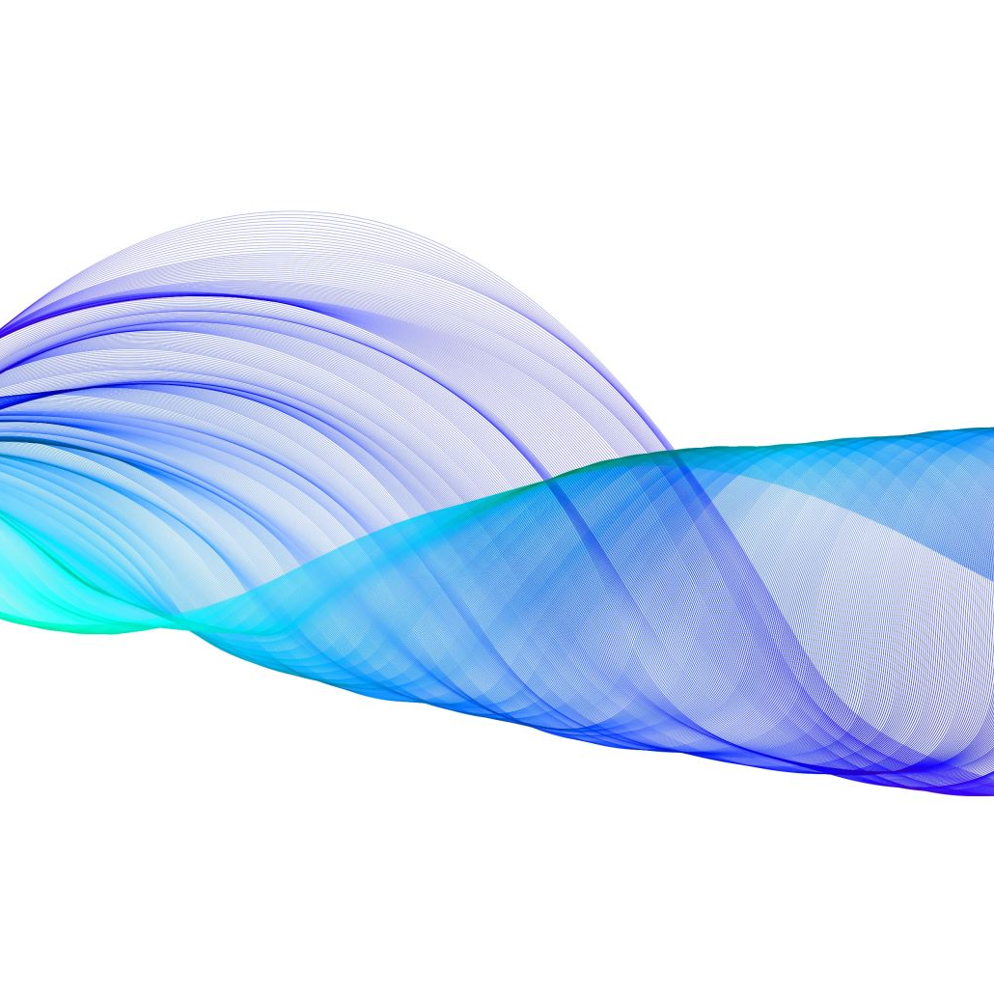
Performance without Anxiety

Slide 2
Empowerment, Voice, Choice
Individual’s strengths are recognised, built on and validated
We strengthen their experience of choice and recognise that each person’s experience is unique

Slide 3
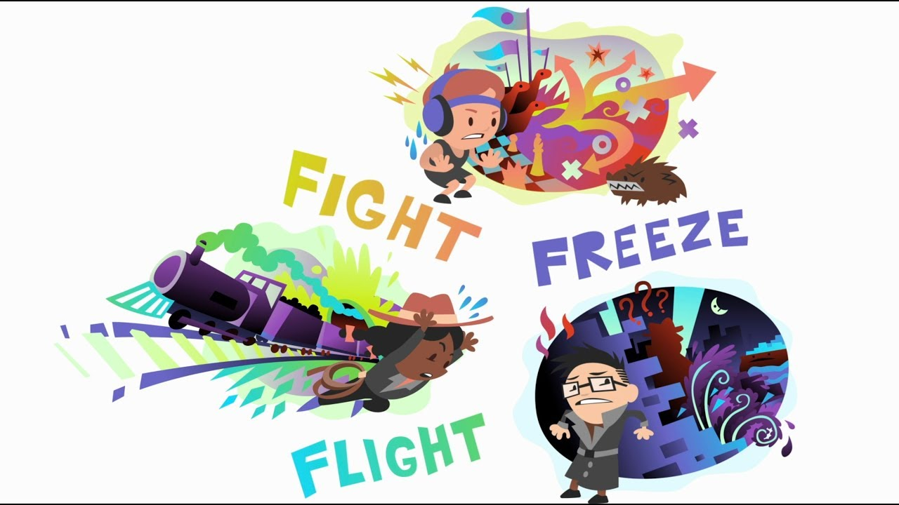

Slide 4


ANS Arousal vs ANS Regulation
Joseph Wolpe, an eminent psychotherapist developed an anxiety reduction intervention in 1958.
He found that most of us face our fears in a state of ANS arousal and
try to ‘brute force’ our way through the situation.
He suggested that we need ANS regulation to achieve peak functioning
and should replace anxiety on a step-by-step basis with a contrasting
stimulus such as relaxation

Slide 5
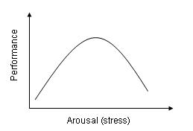
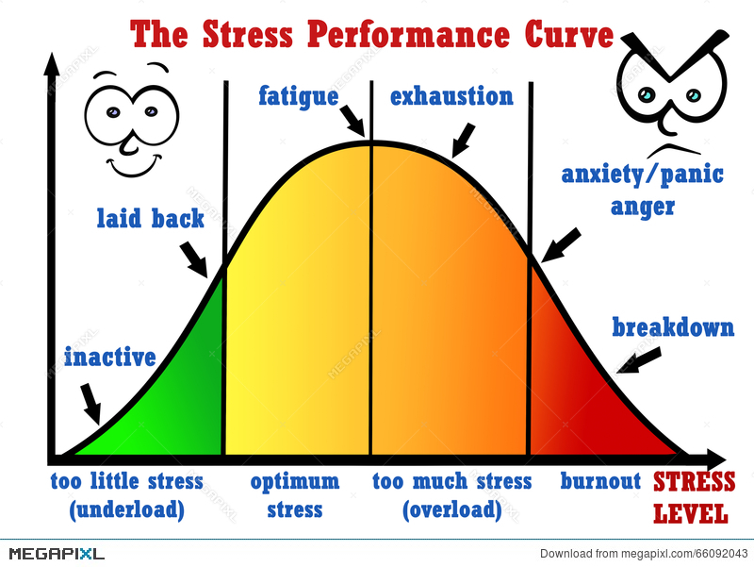
Yerkes-Dodson Human Function Curve

Slide 6
Stress
CAUSES | EFFECTS

Slide 7
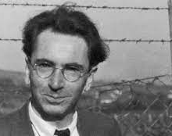
How do we get there?
Between Stimulus and response is a space.
In that space is our power to choose our response.
In our response lies our growth and our freedom
Victor Frankl

Slide 8

Stress = Perceived Threat
Solution = Interoception
Become sensitive to the feedback we receive from our body
Notice the rising energy levels (SNS activation)
Recognise when we need to use consciously and intentional intervention (skill)
Bodyfulness

Slide 9
Skills and Interventions
Breathing exercises
e.g. Square breathing, colour visualisation, word association
Grounding exercises
Sensory, Postural (including peripheral vision)
Muscle relaxation techniques
Progressive Muscle Relaxation, Body Scan, Magic Rectangle
Thought Field Therapy (Tapping)
combining the acupressure meridian system with modern psychology
Anchoring
using a object eg pebble

Slide 10

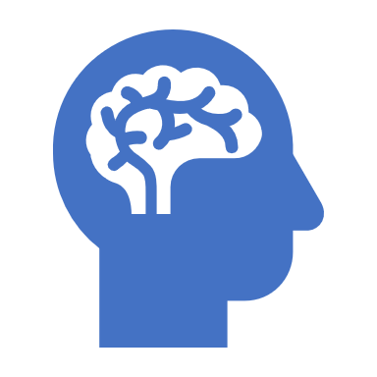
Results
Perceived Threat + Relaxed body = Maximised Neo-Cortical Functioning
Intelligence
Creativity
Humour
Dexterity
Impulse control
Relational skills

Slide 11
In Summary
Intentional shift from Sympathetic Nervous System dominance to Para-Sympathetic dominance
Relax physically to activate parasympathetic system
Interoception – to increase awareness of tension
Learn about the body and stress / threat responses
Learn skills, and practice them to provide ourselves with a toolkit of resources for different situations
Self regulate to stay on the LHS of the Human Function Curve

Slide 12
And Finally….
When people act reactively, rather than intentionally, it is because their nervous system has become so charged with energy that they have:
temporarily lost neo-cortical functioning
become compelled to act with either aggression or avoidance
So be kind, to yourselves and everyone else and remember you are amazing.

